Slide 1
Water Reuse for Irrigation
in Rural Area in Japan
Koji HAMADA
Principal Researcher:
Aquatic Environmental Engineering Unit
Division of Hydraulic Engineering
Institute for Rural Engineering, NARO
Notes:
It is my great pleasure to make a presentation today.
I’m Koji HAMADA from Japan.
I am working on Aquatic environmental conservation in Institute for Rural engineering, NARO; National Agriculture and Rood Research Organization of Japan.
Today, I’d like to talk about information of “Water reuse for irrigation in rural area in Japan”.

Slide 2
Annual Precipitation in Japan
 |  | Japan | Kyrgyz | Global
Precipitation | (mm/y) | 1,668 | 533 | 815
Population | (1,000 inhab) | 127,484 | 6,045
Total area | (1,000 ha) | 37,797 | 19,995
Precipitation per capita | (m³/inhab/yr) | 4,945 | 17,630 | 16,005
AQUASTAT (FAO)
Although Japan in Monsoon Asia is imaged to be enough precipitation, as for “annual precipitation per capita”, Japan has only less than one third of global and Kyrgyz.
Notes:
At first, I’ll take about precipitation in Japan .
As for Japan, annual precipitation is about 1,700 mm and it is about two times larger than global average, and over 3 times larger than Kyrgyz.
But, Japan has large population and high population density.
Although Japan in Monsoon Asia is imaged to be enough precipitation, as for “annual precipitation per capita”, Japan has only less than one third of global average.

Slide 3
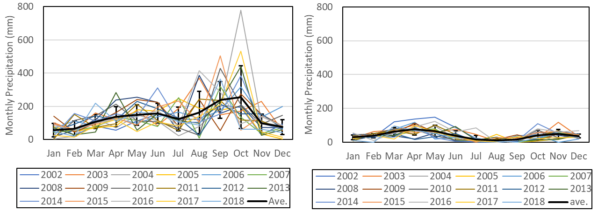
Seasonal Precipitation
Tokyo
Bishkek
Japan, located in Monsoon Asia, receives relatively high rainfall by a seasonal rain front (Jun- Jul) and typhoons (Sep-Oct).
In the summer, seasonal valley of precipitation sometimes causes water scarcity.
Under water-stressed conditions, restrictions on water intake leads to shortage of irrigation water, and there is an urgent need of alternative water resources for sustainable agriculture.
Notes:
This slide shows seasonal precipitation in Tokyo Japan and Bishkek.
These bold lines are averages from 2002-2018.
As you can see, seasonal precipitation is fluctuated.
In particular, in the summer, seasonal valley of precipitation sometimes causes water scarcity.
Under water-stressed conditions, restrictions on water intake leads to shortage of irrigation water, and there is an urgent need of alternative water resources for sustainable agriculture.

Slide 4
TWW as Alternative Water Resource
In recent years, efficiency utilization of treated wastewater for irrigation has been globally focused on as a useful alternative water resource, and international guidelines regarding this have been published (ISO, 2015-2016; WHO, 2006).
Japan is also focusing on treated wastewater reuse in water-stressed regions, for example in remote islands.
In recent years, because Japan has been facing water scarcity in summer, development an effective use of alternative water resources based on the characteristics of them becomes to be more important.
Notes:
In recent years, efficiency utilization of treated wastewater for irrigation has been globally focused on as a useful alternative water resource, and many international guidelines regarding this have been published, for example published by ISO and WHO.
Japan is also focusing on treated wastewater reuse as a useful alternative water resource in water-stressed regions.
In recent years, because Japan has been facing water scarcity in summer, development an effective use of alternative water resources based on the characteristics of them becomes to be more important.

Slide 5
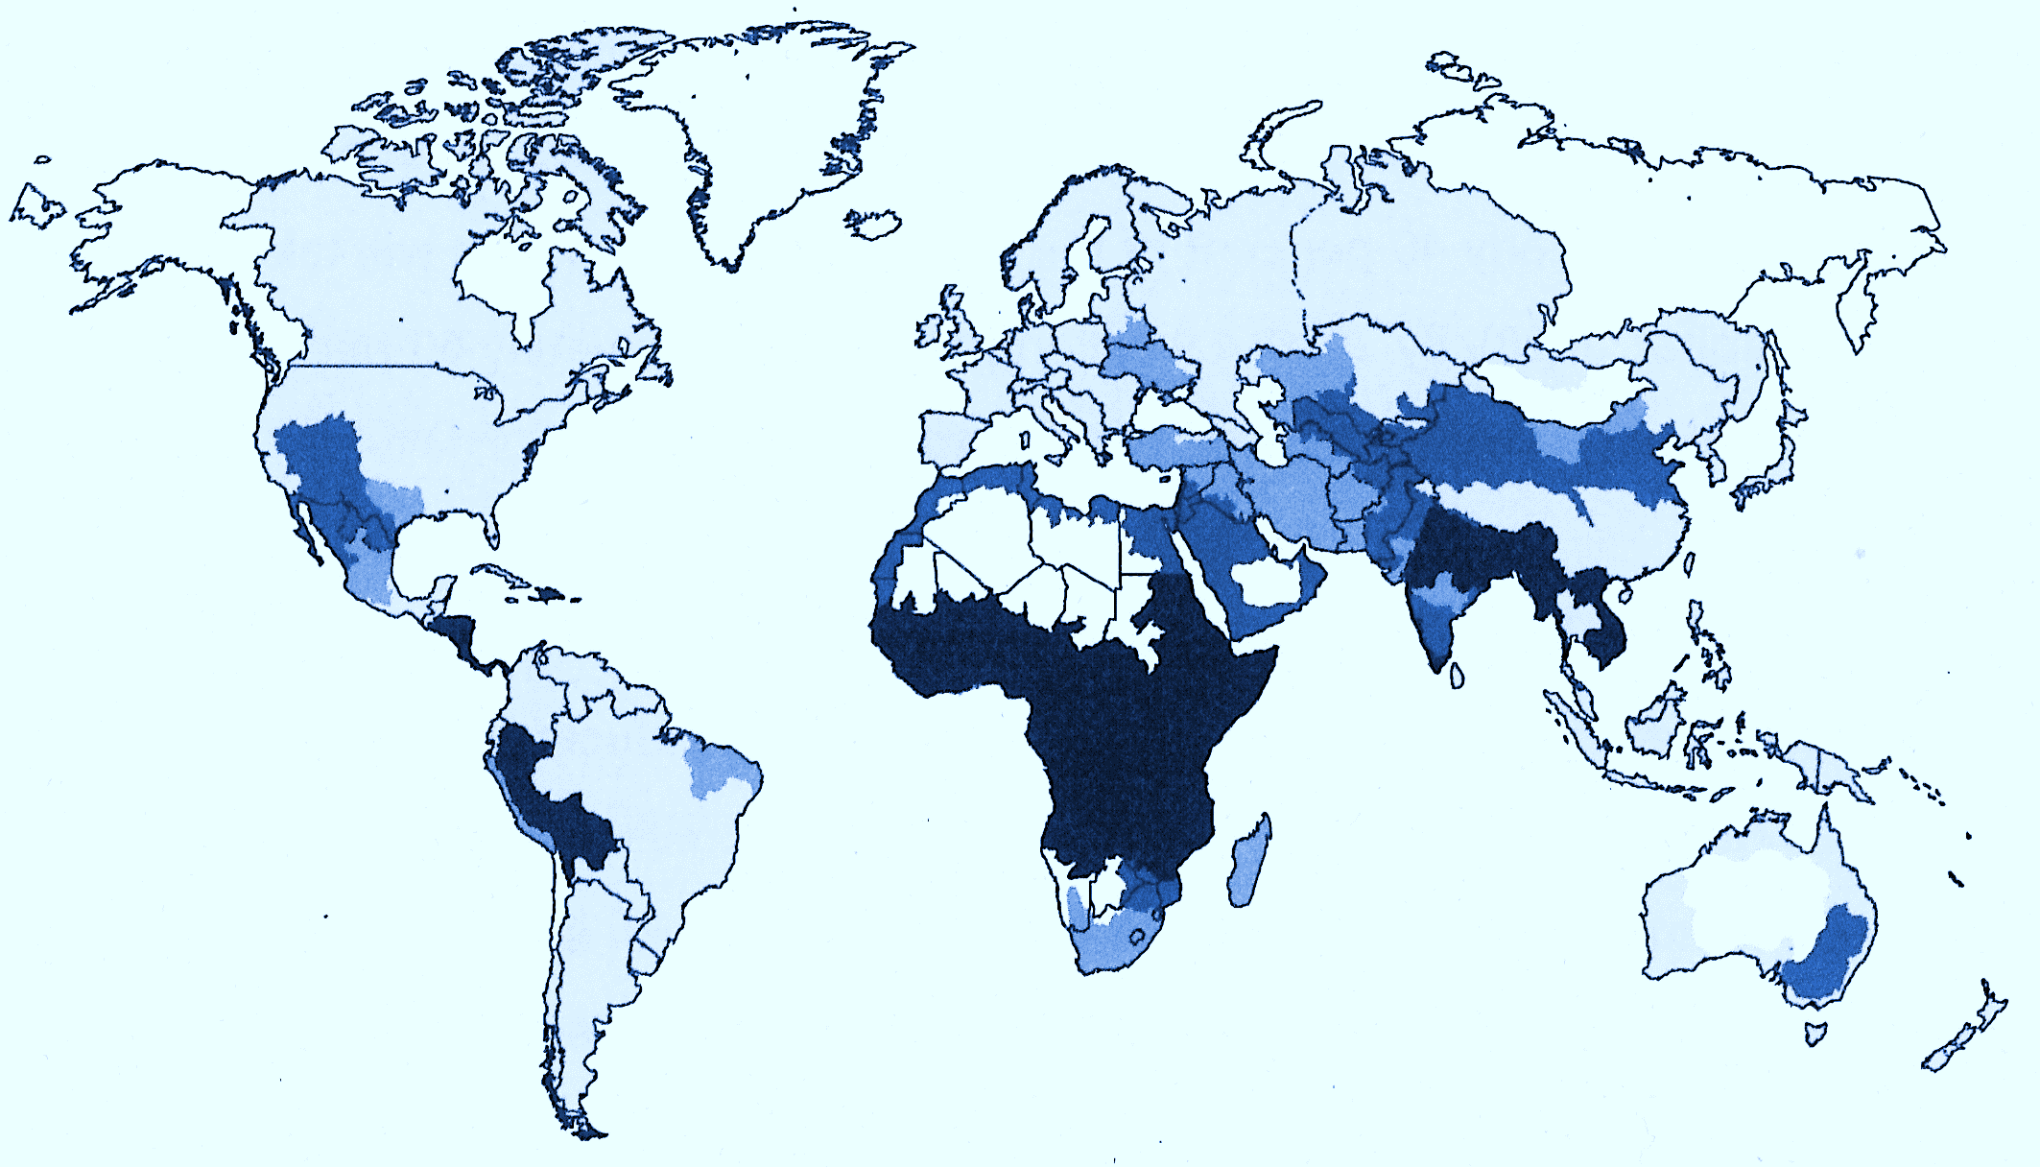
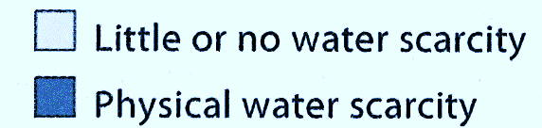


Water Scarcity and Water Reuse
Netherland
Belgium
California
Italy
Algeria
Texas
Singapore
Brisbane
Israel
Namibia
Perth
ISO/TC282/SC1
P-member
O-member
Motivation
Groundwater scarcity
River flow conservation
Water scarcity
Irrigation water scarcity
Notes:
This map shows places where water scarcity, and interest in treated sewage reuse.
These blue colored area shows places where facing water scarcity.
Difference of colors means difference of reason of water scarcity.
Circle plots indicate members of ISO/TC282/SC1 where guidelines for TWW use for irrigation are developing.
Country or city names in colored boxes are famous example of water reusing place.
Colors means the reason why they interest in treated sewage use.
Interest in water reuse is existing around the world, especially places facing water scarcity and in Europe.

Slide 6
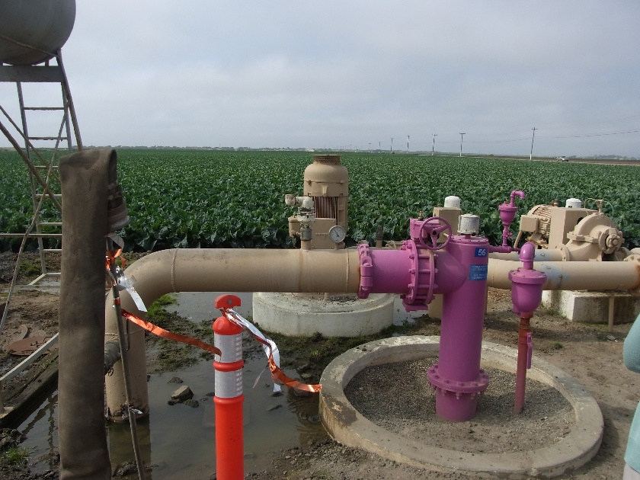
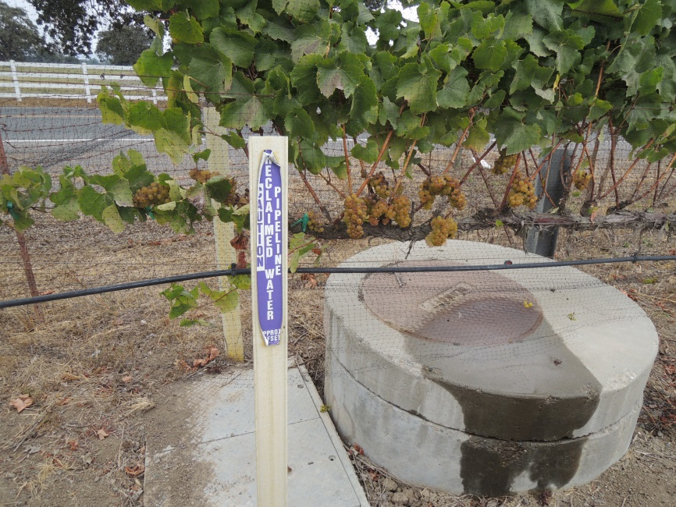

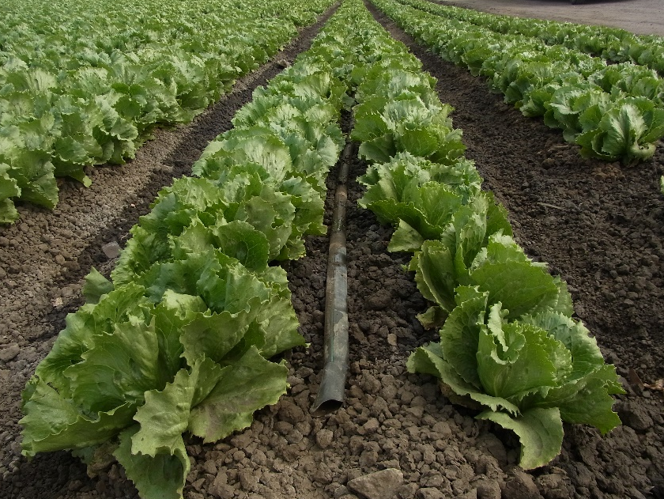
Reuse of Treated sewage for Agriculture
Pipeline
Reclaimed water
Caution
Purple line
These purple line has been installed in areas of water scarcity and they use treated sewage effluent as irrigation water actively.
These activities lead to not only make alternative water resource but also conservation of water environment where Treated sewage effluent used to be discharged.
Drip irrigation
Notes:
These pictures are taken in California as one of the most famous places to treated sewage use for irrigation directly.
These special purple lines have been installed in areas of water scarcity and they use treated sewage as irrigation water very actively.
And these activities lead to not only make alternative water resource but also conservation of water environment where TSE used to be discharged.

Slide 7
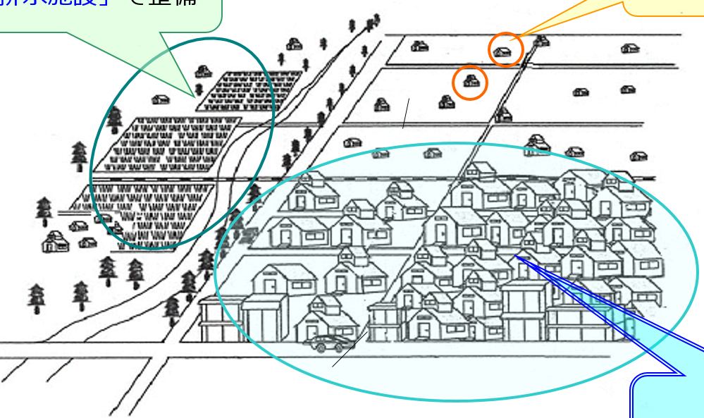
Sewage systems in Japan
Japan has three types of sewage systems.
Rural sewage system
Private system
Urban sewage system
Ref.: Ministry of Land, Infrastructure, Transport and Tourism of Japan
treated water volume
Urban system: Centralized Large Scale System 14,060 Mm³/y
Rural system: Decentralized Small Scale System 00.350 Mm³/y
Private system: Individual System
Notes:
Move to talk about sewage systems in Japan.
Japan has 3 types of sewage systems; urban system, rural system, private system.
And these reach over 90% penetration in Japan.
Regarding to urban system which is a larger scale system.
Although scales are larger, treatment plants locate downstream end of urban area, so farmland plots are far from treatment plant in many cases.
Long distribution system is needed.
In contrast, in rural system, scales are comparative smaller, but treatment plants are very close to farmland plots.
It is easier to use TRSE for irrigation.

Slide 8
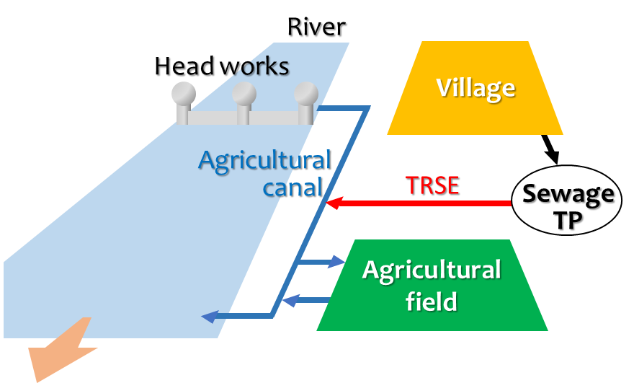
Reuse of Treated Rural Sewage Effluent
Annual treated rural sewage effluent volume : 350 Mm³
Annual agricultural water use :
56,840 Mm³
Irrigation use Rice paddy : 94%
Other crops : 06%
78% of rural area uses TRSE for agriculture.
Treated rural sewage effluent (TRSE) is reused for irrigation indirectly.
Notes:
As for reuse of treated rural sewage effluent.
Annual treated rural sewage effluent volume is smaller.
But, 78% of rural area uses TRSE for agriculture.
Generally, TRSE flow into agricultural canals where fresh water flows.
After that, diluted TRSE with fresh water is taken for irrigation.
Even in rural area, it is even no or very rare case of direct use of TRSE for irrigation.

Slide 9
Notice of Treated Sewage use
ISO (2015-2016) ISO 16075(1-4) - Guidelines for Treated Wastewater Reuse for Irrigation.
WHO (2006) WHO Guidelines for the Safe Use of Wastewater, Excreta and Greywater - Volume II, Wastewater Use in Agriculture.
These two international guidelines considered to most important two points in treated sewage effluent use for irrigation are;
Prevent pathogenic contamination and
Prevent negative effect on soil environment.
Need monitoring and verification.
In contrast, nutrients within TWW are considered to be as chemical fertilizers.
Direct use of TWW for irrigation have advantage compared to indirect use.
Notes:
By the way, These two international guidelines considered to most important two points in treated sewage effluent use for irrigation are;
Prevent pathogenic contamination and
Prevent negative effect on soil environment.
When we use TSE for irrigation, it needs monitoring and varification.
In contrast, nutrients within TWW are considered to be as chemical fertilizers.
Direct use of TWW for irrigation have advantage compared to indirect use.
In particular, efficient use of phosphorus in TRSE becomes to be interesting issue.

Slide 10
Availability of TRSE for Direct Irrigation
Needs of direct use of TRSE might become higher in Japan, due to alternative water resource and water environment conservation.
We evaluated whether water quality suit direct use for irrigation or not.
We measured fecal coliforms as an indicator of pathogens.
Fecal coliforms ： <2～536 cfu/100mL （95%ile：536 cfu/100mL）
According to the ISO guideline, measured values were suitable for irrigating crops that are always eaten after cooking.
Additionally, according to the ISO guideline, we can use it for irrigation crops eaten row with some counter measures such as drip irrigation.
Notes:
Needs of direct use of TRSE might become higher in Japan, due to alternative water resource and water environment conservation.
So, we evaluated whether pathogenic concentration of TRSE suit direct use for irrigation or not.
In Japan, generally, coliform gropes is used for indicator of pathogenic contamination.
According to the ISO guideline, Measured value of the observed TRSE ｗere suitable for irrigating crops that are always eaten after cooking.
Additionally, according to the ISO guideline, we can use it for irrigation crops eaten row with some counter measures such as drip irrigation.

Slide 11
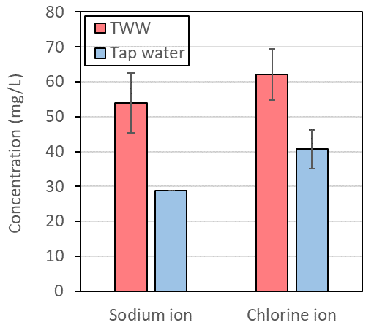
Direct Use of TRSE for Irrigation
Salt concentrations in TRSE were higher than general irrigation water.
SAR of TRSE, which is an indicator for effect on soil structure, was 2.56±0.25.
TRSE suits irrigation use without big hurdle.
 |  | Effect on soil Environment
 |  | Salt accumulation | Note
Rice paddies |  | NP | Leached by down flow of ponded water
Fields | Open culture | NP | Leached by down flow of rainfall
 | Green house | ??? | No rainfall in greenhouses
Notes:
Salt concentrations in irrigation water is important, because higher concentration has a possibility to lead soil salination in the soil.
Salt concentrations of TRSE in observed rural sewage treatment plant were higher than tap water and fresh water.
But it is not so high.
In addition, SAR of TRSE, which is an indicator for effect on soil structure, was around 2.56.
TRSE suits irrigation use without big hurdle.
This table shows availability of TRSE use for irrigation depends on cultivation types from the point of view of effect on the soil environment.
As for paddies and open culture irrigation, salt accumulation should be no problem, because generally water flows in the soil is down flow and it leads leaching.
As for greenhouse cultivation, verification is needed because there are no rainfall.

Slide 12
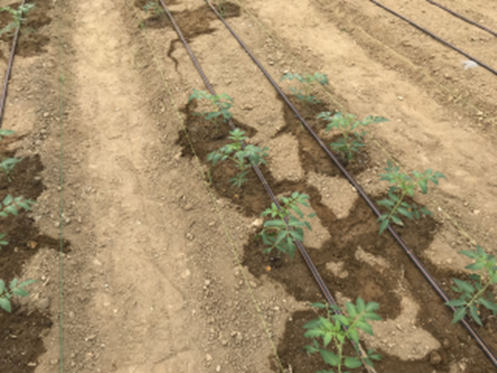
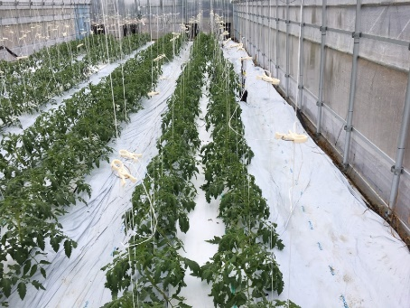
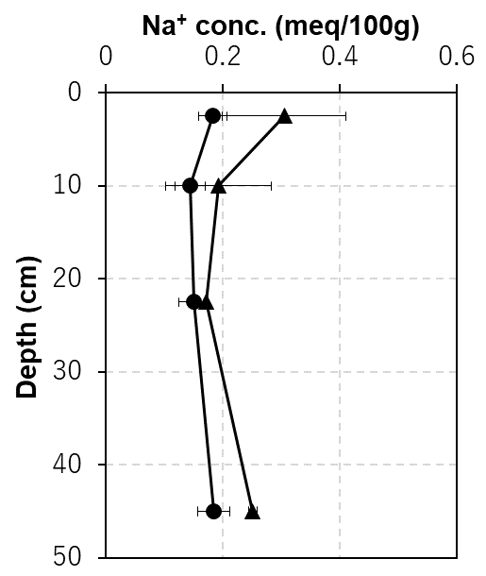
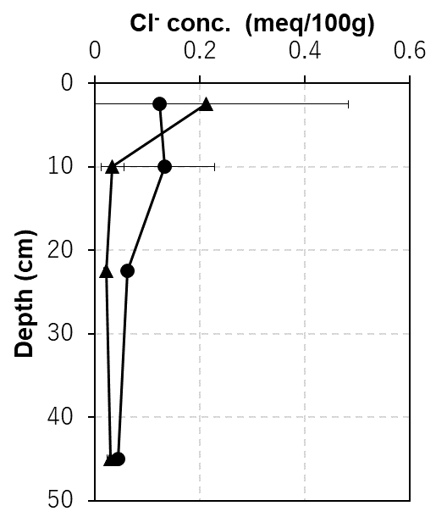
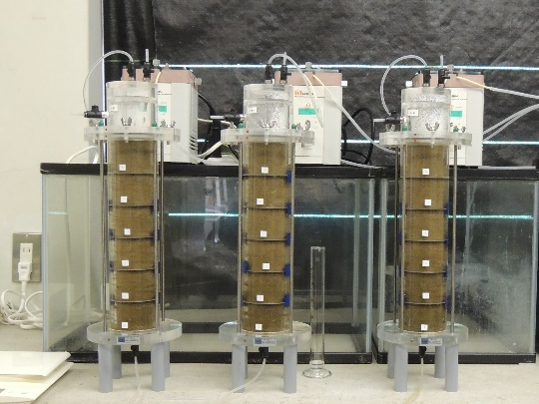
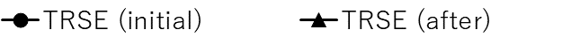
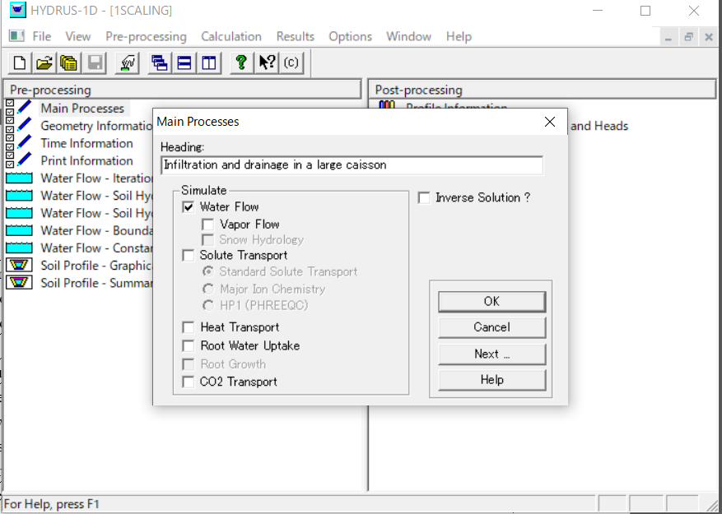
Tomato Cultivation Using TRSE
- We cultivated tomato by direct use of TRSE using drip irrigation in a greenhouse.
Drip irrigation
Weed control sheet
Now, we continue to evaluate of long-term TRSE irrigation on soil environment using in combination with additional column test and numerical experiment.
TRSE
Na⁺
TRSE
Cl⁻
Changes of concentrations in soil extracts did not indicate significant difference compared to control cultivation using tap water.
Notes:
So, we cultivated tomato by direct use of TRSE using drip irrigation in a greenhouse.
To evaluate an effect on soil environment, we measured sodium ion and chlorine ion concentrations in soil extract in initial and after the single test cultivation.
Sodium ion was increased, and chlorine ion indicated the tendency of decrease.
Changes of concentration in soil extracts did not indicate significant difference compared to control cultivation using tap water.
It means effect on soil was very small in short-term single cultivation.
And now, we continue to evaluate of long-term TRSE irrigation on soil environment using in combination with additional column test and numerical experiment.

Slide 13
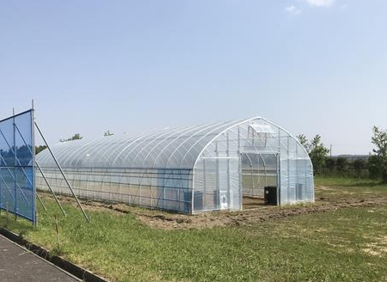
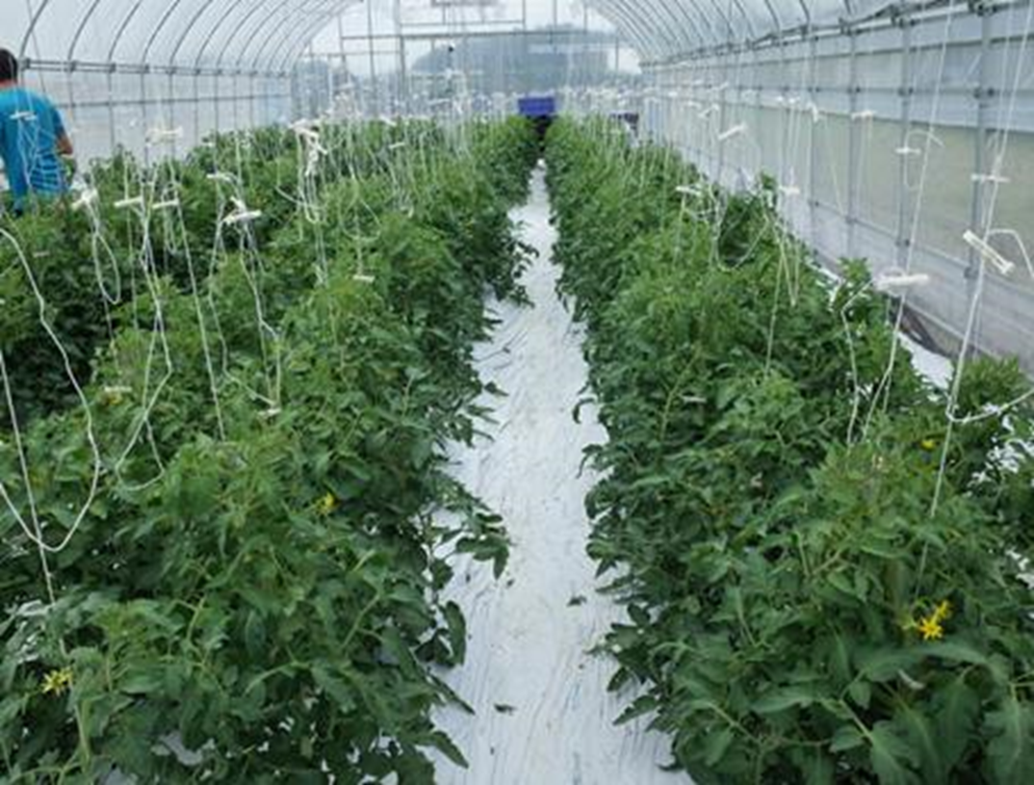
Summary
Water quality of Treated Rural Sewage Effluent (TRSE) is suitable for agricultural reuse, and its negative effect on soil environment would be insignificant, if any; further, it is good even for reuse in greenhouses.
Positive reuse of TRSE, which is supplied close to farmland, will secure comparatively stable and safety water resource and, it for irrigation will appropriate to one of the solutions for water stress improvement and aquatic environment conservation around rural area in Japan.
Notes:
At last, I summarize my presentation.
In Japan, water quality of TRSE is suitable for agricultural reuse, and its negative effect on soil environment would be insignificant, if any; further, it is good even for reuse in greenhouses.
Positive reuse of TRSE, which is supplied close to farmland, will secure comparatively stable and safety water resource and, it for irrigation will appropriate to one of the solutions for water stress improvement and aquatic environment conservation around rural area in Japan.

Slide 14
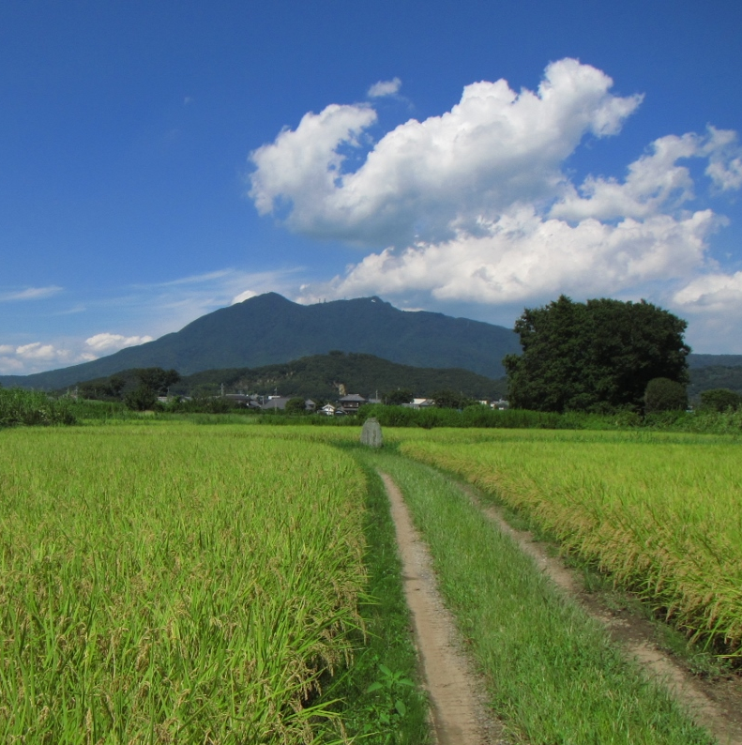
Thank you for your attention.
Notes:
Thank you very much for your attention.

Slide 15
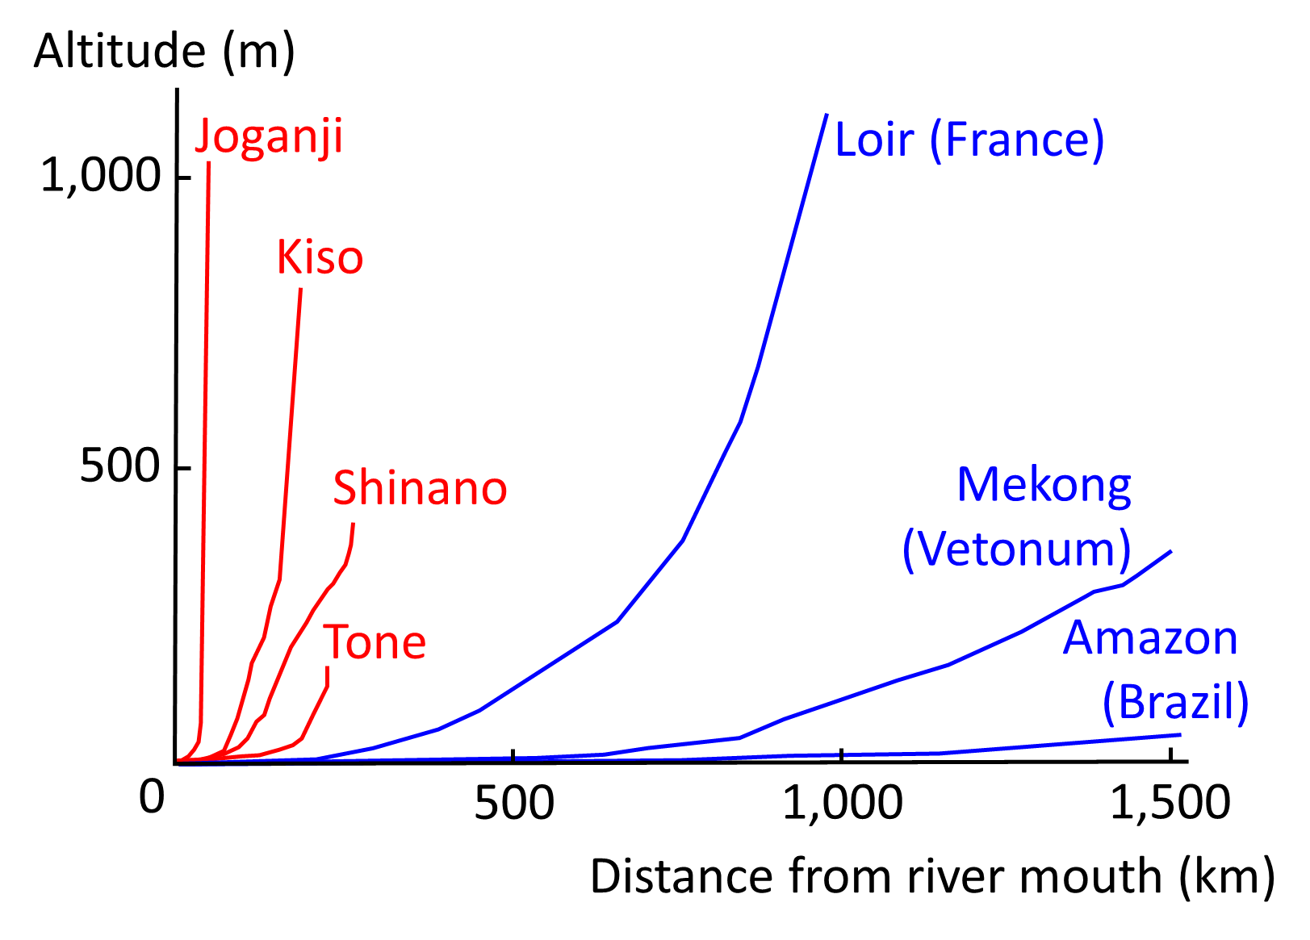
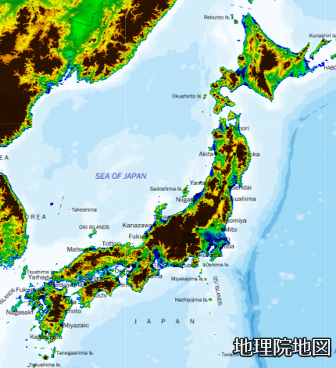
Slope of Japanese River
Eurasia continent
Over 60% is covered with mountain area.
0-10m
10-30m
30-50m
50-100m
100-250m
250-500m
>500m
Japanese rivers are steeper compared to rivers in abroad.
Retention time of rivers are short, and collected rain to rivers flow away to ocean immediately.
Japan
The map of main part of Japan published by Geospatial Information Authority of Japan
Notes:
Move to characteristics of Japanese river.
This figure shows land altitude of main part of Japan.
As you can see in this Figure, over 60% of Japanese area is covered with mountain area.
And it is very close between mountain areas and coasts.
And, look at this graph which shows river slopes.
As you can see, Japanese rivers of red lines are steeper compared to rivers in abroad in blue lines.
Retention time of rivers are short and collected rain to rivers flow away to ocean immediately.
And utilization efficiency of rain for water resource becomes to be low when it rains heavily.

Slide 16
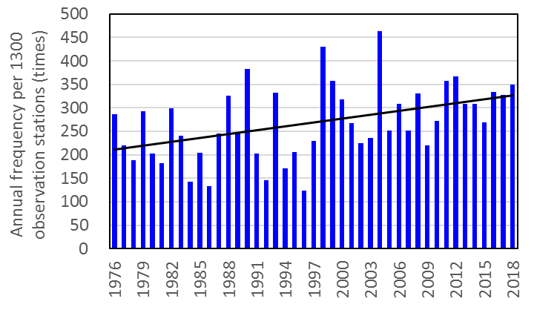
Changes in Precipitation Pattern
Annual frequency of over 50 mm/h precipitation in Japan indicates trends of increasing.
Generally, rainfall pattern all over Japan indicates trends of increasing downpours and increasing no-precipitation days.
Annual frequency of over 50 mm/h precipitation in Japan
Changing rainfall pattern can potentially cause water stress in a wider area beyond the generally recognized water-stressed regions.
Under water-stressed conditions, restrictions on water intake leads to shortage of irrigation water, and there is an urgent need of alternative water resources for sustainable agriculture.
Notes:
This figure shows Annual frequency of over 50 mm/h precipitation in Japan.
Annual frequency indicates trends of increasing.
And in this situation, efficient rain water use is difficult, and some area facing restrictions on water intake from rivers.
Changing rainfall pattern can potentially cause water stress in a wider area beyond the generally recognized water-stressed regions.
Under water-stressed conditions, restrictions on water intake leads to shortage of irrigation water, and there is an urgent need of alternative water resources for sustainable agriculture.

Slide 17
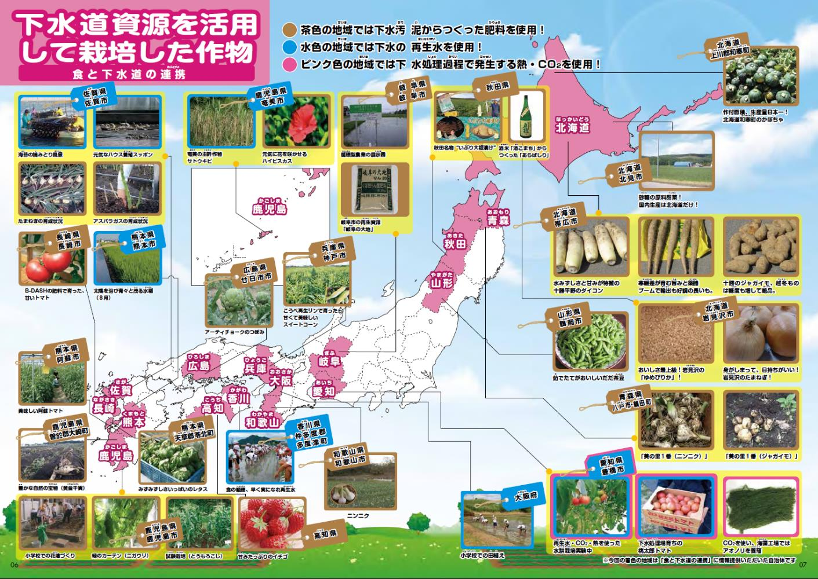
Reuse of Treated Municipal Sewage Eff.
Reused treated municipal sewage
: 190 Mm³/yr (1.4% of total treated)
Toilet flushing 03.2%
Landscaping 23.0%
Recreation 02.8%
min river flow keeping 31.0%
Snow melting 23.0%
Road maintenance 00.2%
Agriculture 05.9%
Industry 01.3%
Office 09.4%
Treated municipal sewage reused for agriculture (11.2 Mm³/yr) is equal to 0.02% of total agricultural water use (56,840 Mm³/yr).
Treated municipal sewage effluent use for irrigation has been expanding, but it is used after dilution with fresh water.
Direct use project is still rare case.
(Ministry of Land, Infrastructure, Transport and Tourism of Japan, 2008)
Notes:
As for municipal sewage systems.
In Japan, only 1.4% of total TMSE is reused.
Main applications of TMS are for landscaping, river keeping and snow melting.
Agricultural reuses of TMS are 5.9% of total reuse, which is 11.2 million ton/year.
And, it is only 0.02% of total agricultural water use.
This figure shows examples of cultivated crops using products supplied from municipal sewage treatment such as treated sewage and digested sludge.
It’s too small to see, but the blue label in the figure is the examples of use of TMS for agriculture.
Treated municipal sewage effluent use for irrigation has been expanding, but it is used after dilution with fresh water.
Direct use project is still rare case.

