Slide 1
Institutional Review Board

Slide 2
Institutional Review Board (IRB) is an AUCA Faculty Senate Committee that is responsible for conducting review and clearance of all research projects within the AUCA that entail collecting data from human subjects. In its proceedings, IRB is guided by general principles of ethics in research and internationally recognized documents.
Purpose: To determine if the rights and welfare of human subjects in research are adequately protected.

Slide 3
Key terms related to IRB review

Slide 4
What is Research?
Research is a systematic investigation designed to develop or contribute to generalizable knowledge via dissemination of results, such as publications or conferences.
E.g. of methods: interviews, surveys, observation, case studies, analysis of existing data, etc.
Note: IRB approval must be obtained for all theses and dissertation research even if there is no intention to publish or disseminate the results.

Slide 5
Who are Human Subjects?
Human subjects (or human participants) - living individuals about whom an investigator obtains:
Data through intervention or interaction with the individual
or
Identifiable private information

Slide 6
Identifiable private information
Includes: contact details, name, last name, address, and other personal details which can lead to identification of the person by third parties.
In some cases, personal sensitive data includes voice and appearance of the respondent which are collected while audio or video recording.

Slide 7
Belmont Report
The National Commission for the Protection of Human Subjects of Biomedical and Behavioral Research, 1976, USA. https://www.hhs.gov/ohrp/regulations-and-policy/belmont-report/index.html
The Belmont Report identifies three basic ethical principles for conducting research that involve human subjects:
Respect for persons
Beneficence
Justice

Slide 8
Respect for Persons
Respect for persons is a principle of ethics which involves recognition of the personal dignity and autonomy (i.e., right to choose) of individuals, and special protection of those persons with diminished autonomy.
This principle requires obtaining informed consent from all potential research subjects (or their legally authorized representatives).
Participants have the right to control the information about themselves (i.e., privacy).
No coercion.

Slide 9
Informed Consent
Informed consent – is the process of explanation of the study (in everyday language) for potential participants, we all we the form participants sign:
Gives information about the procedures, potential risks and benefits to ensure people participate voluntarily.
Informed consent is a must for all studies, unless there is a valid justification for the informed consent waiver.
Anonymous surveys may not require signed informed consent, but information with all the elements of informed consent should be provided to participants.

Slide 10
Vulnerable Populations
Vulnerable populations involve human subjects considered particularly susceptible to coercion or undue influence in a research setting. Individuals within vulnerable populations may have limited autonomy, may be incapable of understanding what it means to participate in research and/or may not understand what constitutes informed consent.
E.g.: children, cognitively impaired, prisoners, pregnant women and fetuses, students of the professor conducting research, etc.
Researchers must provide justification for the use of vulnerable populations within research.

Slide 11
Beneficence
Beneficence requires that researchers protect persons from harm by maximizing anticipated benefits and minimizing possible risks of harm.
Research-related risks must be reasonable in light of expected benefits.
Risk - a combination of the probability of experiencing a harm and the severity of the envisioned harm.
Benefit - something of positive value related to health or welfare of the subject. (Benefit does not include the monetary compensation for participation!)

Slide 12
Justice
Justice requires that the benefits and risks of research be distributed fairly.
Subject selection principles must be justified both scientifically and ethically.
Different groups should be treated fairly.
In other words, it is important to determine whether certain social classes or groups of people are not unjustly targeted for research, for example, because of ease of recruitment.

Slide 13
All AUCA faculty, staff and students who conduct research involving human subjects are required to have approval from the IRB
PRIOR to start of data collection. Contacting your participants also qualifies as data collection.

Slide 14
A project DOES NOT require an IRB clearance if:
No data is collected about or from human subjects (e.g., animals and weather).
Uses anonymized secondary or archival data (for which consent has been taken before)
There is no intent to publish the results in the form of conference presentations, thesis defense, journal or conference publications, whitepapers, or public opinion posts.
Data is collected from human subjects in commonly accepted educational settings and involve standard educational practices (for example, data collected to illustrate a concept in a class).
Data is collected from human subjects for purposes of learning a data-collection method (student class project).
All other research projects involving human subjects assuming future publication or dissemination of findings need IRB clearance. Student dissertations and senior theses need IRB clearance.

Slide 15
How to Apply?
Applications are completed and submitted electronically via the IRB Engine (https://review-irb.auca.kg/en/login). To register in the system, you have to:
Study IRB manual
Take an exam
To learn more about the application process, please visit https://auca.kg/en/res_irb_inst/.

Slide 16
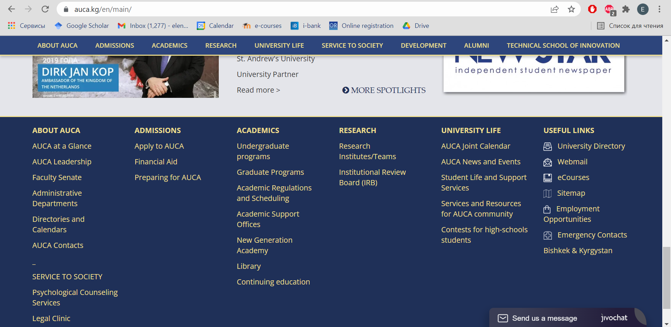

Slide 17
Types of Review
Exempt from Full Review
Expedited Review
Full Board Review
To learn more about review types, please visit: https://auca.kg/en/res_irb_rev/.

Slide 18
Exempt from Full Review
Research poses no more than Minimal Risk to participants.
Risk can be the result of collecting data from vulnerable populations or exposing participants to situations which might lead to stress due to the topics of discussion or questions or the context.
Minimal Risk means facing no more stress during a research and in everyday life.
Research involves ordinary educational settings and normal educational practices.
Anonymous tests, surveys, or public observations.
Research uses existing public or anonymous data or specimens, where all data is originally de-identified.
Exempt from Full Review applications are accepted on a rolling basis (with no deadlines).

Slide 19
Expedited Review
Research activities present no more than Minimal Risk to participants, just like Exempt from Review type.
Collection of data from voice, video, digital, or image recordings made for research purposes.
Research on individual or group characteristics/behavior, surveys, interviews, focus groups or oral histories that are confidential, but not anonymous.
Expedited Review applications are accepted on a rolling basis (with no deadlines).

Slide 20
Full Board Review
Any research that involves more than Minimal Risk to participants.
Risk can be the result of collecting data from vulnerable populations or exposing participants to situations which might lead to stress due to the topics of discussion or questions or the context.
Principal Investigator (PI) must complete and submit application for Full IRB
Review is conducted according to the deadlines on IRB website (https://auca.kg/en/res_irb_impdates/ ).

Slide 21
Review time
The length of time for review depends on a number of factors:
The category of review is required:
Exempt & Expedited: 14 business days for review after application submission.
Full Board: 14 business days for review after each submission deadline.
The completeness of an application.

Slide 22
CONTACTS
AMERICAN UNIVERSITY OF CENTRAL ASIA, INSTITUTIONAL REVIEW BOARD
Address: 7/6 Aaly Tokombaev str., Bishkek, 720060, Kyrgyz Republic
TEL: +996 (312) 915 000
FAX: +996 (312) 915 028
Website: https://irb.auca.kg/
Email: irb@auca.kg

