Slide 1
Water Problem Institute of Russian Academy of Sciences project
«INTERSTATE WATER RESOURCE RISK MANAGEMENT: TOWARDS A SUSTAINABLE FUTURE FOR THE ARAL BASIN»
JAYHUN
MIKHAIL BOLGOV, Head of the laboratory
Commission of the European Communities and University of Hannover,
contract number 516761

Slide 2
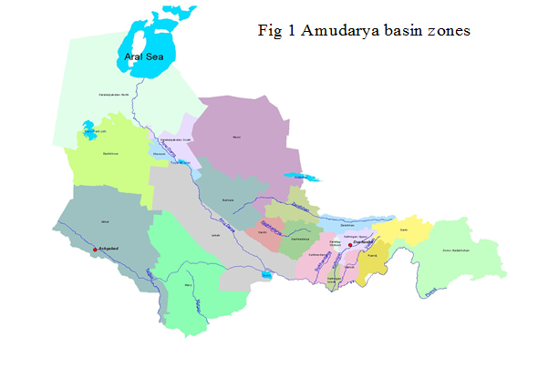

Slide 3
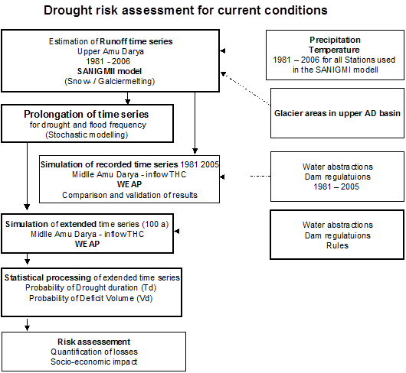

Slide 4
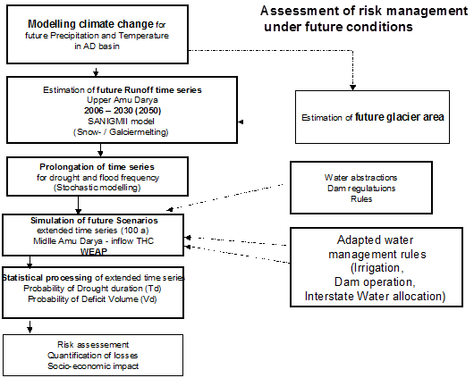

Slide 5
air temperature and precipitation
For approximation of air temperature and precipitation on stations included into calculation model, the grid points of the Tyndall Centre temporal model were chosen. Approximation was made by means of multiple regression analysis using method of analogies.

Slide 6
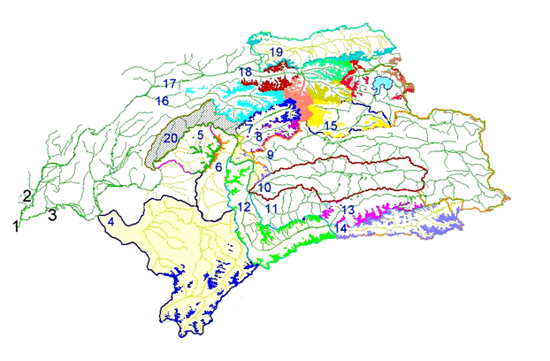
Glaciological data base
Glaciers in the Upper Amudarya basin. 1 – river Amudarya, 2 – river Vakhsh,
3 – river Pyandj, 4-15 tributaries of the Pyandj river (4 – Kunduz, 5 – Kufab, 6 – Sheva, 7 – Vanch, 8 – Yazgulem, 9 – Bartang and Murgab, 10 – Gunt, 11 – Shahdara, 12 – right and left tributaries of Pyandj downstream the confluence of Pamir and Vahandarya rivers, 13 – Pamir, 14 – Vahandarya, 15 – Kudara), 16-20 are tributaries of Vakhsh river (16 – Obihingou, 17 – Surhob, 18 – Muksu, 19 – western Kyzylsu, 20 – right tributaries of Vakhsh downstream the Vanch river mouth ).

Slide 7
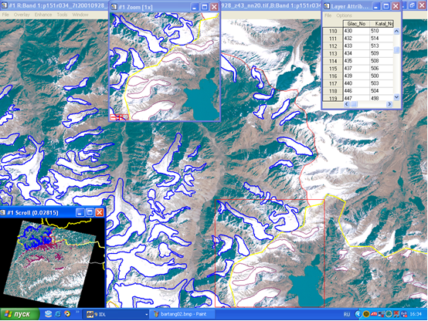
Interpretation of borders of the Bartang glaciers in program ENVI v.4.2.

Slide 8
Long term change of glaciers area in the Upper Amudarya River (km2)

Slide 9
Математическое моделирование стока горных рек, Ю.М. Денисов

Slide 10
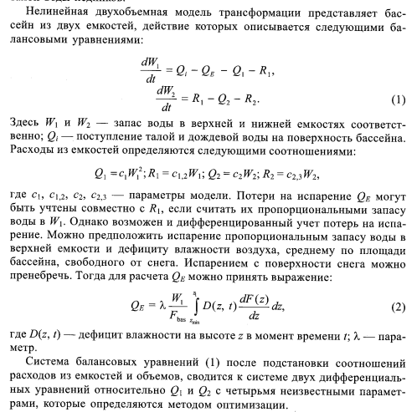

Slide 11
Stochastic modeling of the river runoff and meteorological characteristics.
To estimate reliability of the water utilization system functioning of the Amu-Darya basin, the stochastic model is proposed which allows reproducing of long runoff series in its formation zone. On this stage, the parameters of the runoff distributions of the catchments under investigation correspond with stationary modern climatic conditions. On the next stage, they will be replaced by the new ones, corresponding to modern glaciation and the changed (forecasted) climatic conditions.
For the imitation modeling, the information from 6 points was taken: 1)Pyandj – Hyrmandzhow, 2) Vakhsh – Komsomolabad, 3) Kafirnigan – Tartki, 4) Surkhondarya – Manguzar, 5) Kunduz – Puli – Kumry, 6) Kokcha – Hodzhagar

Slide 12
The algorithm of the multidimensional vector modeling is based on the decomposition of the field along eigenfunctions. It reproduces random variables having the given parameters of one-dimensional distributions, correlation matrix and the first value of the autocorrelation function (it is enough in the Markov approach).

Slide 13
Modeling of monthly values of precipitation and temperature is executed according to the scheme of the SAR- Model, i.e. the one having the seasonal trend removed. For the model adjustment, matrixes of spatial correlation, autocorrelation functions for each month and the distribution parameters of precipitation and temperature are estimated for the meteorological stations: Garm, Gulcha, Gushary, Hovaling, Fedchenko and Tavyldara.

Slide 14

Bayesian decision for flow evaluation in multi scenario conditions
Further processing can be continued in two ways. First, we can accept one of values θ as estimated parameter, for example, position measure or average of distribution. In some cases, for introduction of reserves into results of calculations, it is possible to assume quantile of a posteriori distribution .
The second way consists in the construction of forecasted frequency distribution of probabilities of water runoff on the base of the formula of total probability. In that case forecasted frequency is estimated as follows:

Slide 15
КРИВЫЕ ОБЕСПЕЧЕННОСТИ СТОКА
Р.ВАХШ - П.КОМСОМОЛАБАД ДЛЯ РАЗЛИЧНЫХ КЛИМАТИЧЕСКИХ СЦЕНАРИЕВ
Квантили распределения годового стока р.Вахш – п. Комсомолабад, (байесовская оценка)
№ | Период прогноза, лет | Вес для сценария, % |  |  | Обеспеченность, %
 |  | 1 | 2 | 3 | 50 | 75 | 90 | 95 | 97
1 | 30 | 50 | 25 | 25 | 560 | 510 | 468 | 444 | 429
2 | 50 | 50 | 25 | 25 | 539 | 479 | 731 | 407 | 392

Slide 16
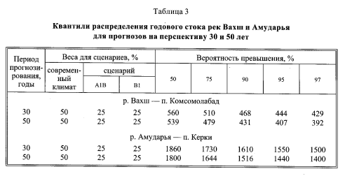

Slide 17
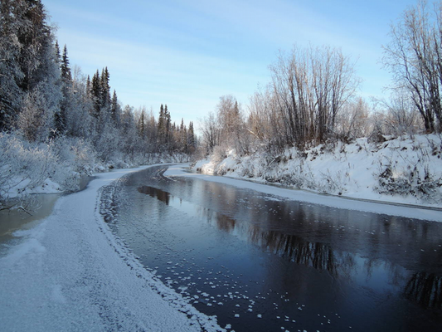
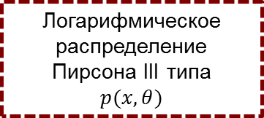
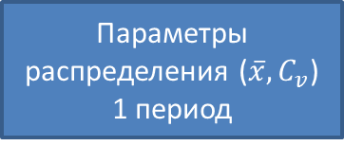

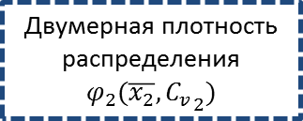
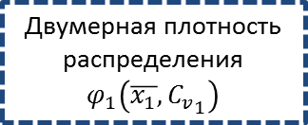

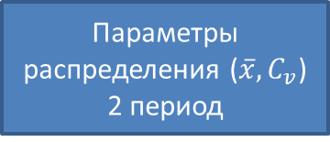
СХЕМА ПРОГНОЗА МИНИМАЛЬНОГО СТОКА
Минимальный 30-тидневный зимний сток (наблюдения)
Параметры распределения ($\overline{x}, C_{v}$)
1 период
Параметры распределения ($\overline{x}, C_{v}$)
2 период
Логарифмическое распределение Пирсона III типа
$$p(x,θ)$$
Река Уса. Фото А.Усачева
Двумерная плотность распределения $φ_{1}\left(\overline{x_{1}},{C_{v}}_{1}\right)$
Двумерная плотность распределения
$$φ_{2}(\overline{x_{2}},{C_{v}}_{2})$$
Построение прогнозной плотности распределения минимального стока по формуле Байеса
$$π(x/y)=\int_{θ}{p\left.(x,θ\right)φ\left(θ/y)dθ\right.}$$
Априорная плотность двумерного распределения
$$φ\left(\overline{x,}C_{v}\right)=\frac{n_{1}}{n_{1}+n_{2}}φ_{1}\left(\overline{x_{1}},{C_{v}}_{1}\right)+\frac{n_{2}}{n_{1}+n_{2}}φ_{2}(\overline{x_{2}},{C_{v}}_{2})$$
17

Slide 18
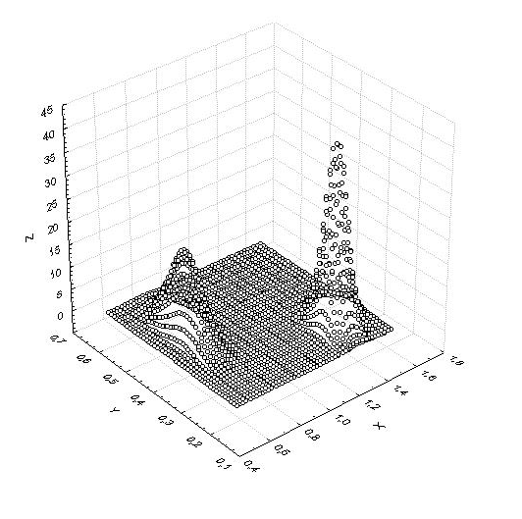
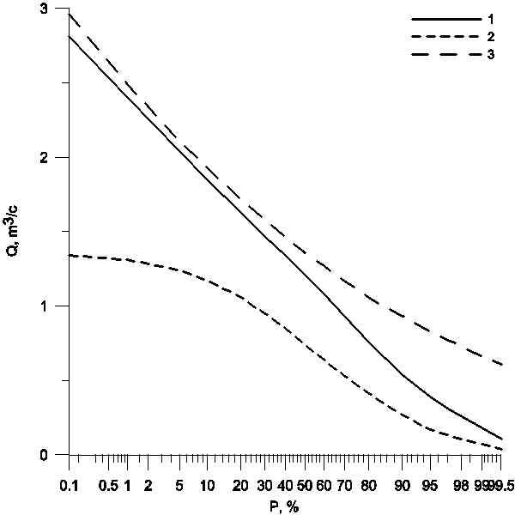
ВЕРОЯТНОСТНЫЙ ПРОГНОЗ МИНИМАЛЬНОГО ЗИМНЕГО СТОКА В УСЛОВИЯХ КЛИМАТИЧЕСКИХ ИЗМЕНЕНИЙ
Априорная плотность совместного распределения выборочных оценок среднего и C_{v} 30-тидневного минимального зимнего стока*
Кривые обеспеченности 30-тидневного минимального зимнего стока*
(1 – прогноз, 2 – за период наблюдений до 1978 г., 3 – за период наблюдений после 1978 г.)
* Бассейн р. Волга, р.Бузулук, д. Перевозниково
18

Slide 19
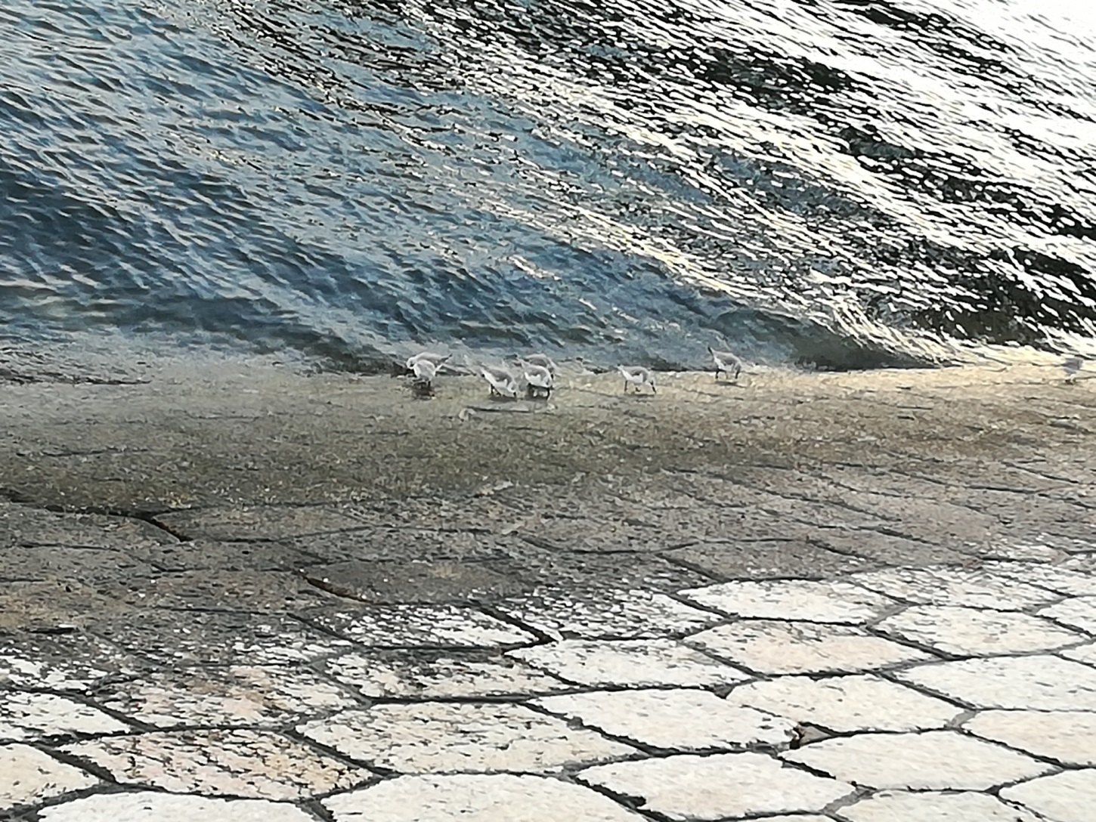
РАХМАТ!

